Slide 1
OLIST STORE E-COMMERCE Analysis
Group 4:
Sudhanshu Khilar
Polavarapu Kanaka maha Lakshmi Devi
Chodagiri Anil kumar
Barakula Rohith kumar
Vaddadi Hemasundar
Priti Ramlal Y Yadav
Trupti Anil Kathale

Slide 2
Introduction
Olist is a leading e-commerce platform that connects sellers and customers through an online marketplace. The platform generates large volumes of transactional data related to orders, customers, payments, and products. Analyzing this data helps businesses understand sales performance and customer purchasing behavior. This project focuses on transforming raw e-commerce data into meaningful insights. Various analytical tools such as excel, SQL, tableau, and power BI are used in this analysis. The goal of the project is to identify key trends, patterns, and kpis that support business decision-making. An interactive dashboard is created to visualize the insights effectively. This analysis helps improve strategic planning and operational efficiency.

Slide 3
Data Overview
Dataset Source: Olist E-commerce Dataset
The dataset consists of 9 CSV files representing 9 relational tables
Each table stores specific business information
Key tables include Orders, Customers, Payments, Products, Sellers, Order Items, Reviews,
Geolocation, and Product Category
Data Type: Structured relational data
Suitable for SQL querying, data analysis, and dashboard creation

Slide 4
Analysis
Order & Payment Analysis: Analyzed order patterns across weekdays and weekends and studied customer
payment preferences to understand purchasing behavior.
Customer Satisfaction & Delivery Performance: Evaluated review scores and delivery times, especially for the pet_shop category,
to measure their impact on customer satisfaction.
Location-Based Insights: Performed city-wise analysis, focusing on São Paulo,
to identify high-value customer locations and revenue contribution.
Business Insights & Trends: Identified key trends, patterns, and correlations using visual analytics and
converted them into actionable business insights.

Slide 5
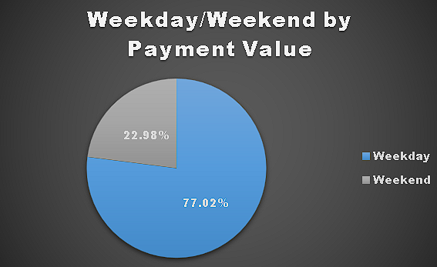
Objectives : kpi’s
KPI-1: Weekday vs Weekend Orders
Insights :
Weekday orders are higher compared to weekend orders, indicating business-driven purchasing behavior.
Business Impact :
• Indicates business-driven purchasing behaviour
• Opportunity to increase weekend sales using offers

Slide 6
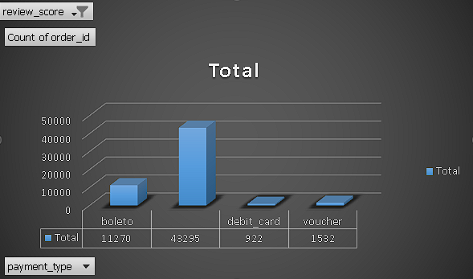
KPI-2: Payment Method Analysis
Insights :
Credit cards are the most preferred payment method among customers.
Business Impact:
• Promote credit card offers & cashbacks
• Improve checkout experience for card users
Credit card

Slide 7

KPI-3: Delivery Time – Pet Shop Category
Insights :
The pet shop category shows noticeable variation in delivery time.
Business Impact:
• Need better logistics planning for this category
• Faster delivery can improve customer satisfaction

Slide 8
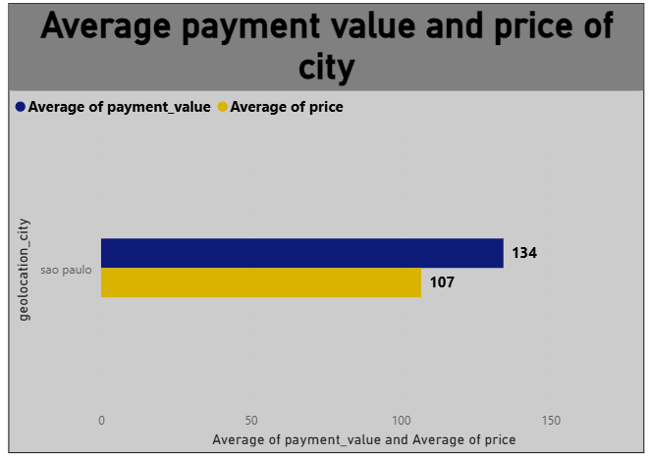
KPI-4 : Location-Based Revenue Analysis
Insights :
Customers from são paulo contribute significantly
to total order value.
Business Impact:
• São Paulo is a high-value market
• Focus marketing & premium products in this region

Slide 9
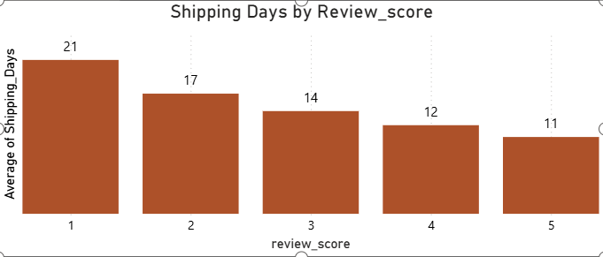
KPI-5 : Shipping Days by Review score
Insights :
Orders with faster delivery times tend to
receive higher review scores.
Business Impact :
• Delivery speed directly impacts customer satisfaction
• Improving logistics improves brand reputation

Slide 10
Process
Collected the Olist e-commerce dataset consisting of 9 CSV files
Loaded and explored the data using Excel for initial understanding
Cleaned the data by handling missing values and formatting date fields
Imported the cleaned data into SQL for structured analysis
Performed joins between tables using primary and foreign keys
Created calculated fields and KPIs using SQL queries
Visualized KPIs using Tableau and Power BI
Designed an interactive dashboard with filters and slicers
Data transformation was performed at each stage to ensure data accuracy

Slide 11
INSIGHTS
Prioritize high-performing product categories to drive overall revenue growth.
Strengthen delivery and logistics efficiency to minimize delays and improve customer satisfaction.
Introduce customer retention strategies such as loyalty programs and personalized offers to encourage repeat purchases.
Promote digital payment options by providing incentives like cashback and exclusive deals.
Schedule targeted marketing campaigns during peak sales periods such as weekends and festive seasons to maximize sales impact.

Slide 12
RECOMMENDATIONS
Introduce special offers and discounts during weekends to increase order volume.
Encourage digital and credit card payments through cashback or reward programs.
Improve logistics and delivery timelines to enhance customer satisfaction.
Optimize supply chain processes for categories with longer delivery times.
Focus marketing efforts on high-value customers and key cities like são paulo.
Use customer feedback and review analysis to improve service quality.

Slide 13
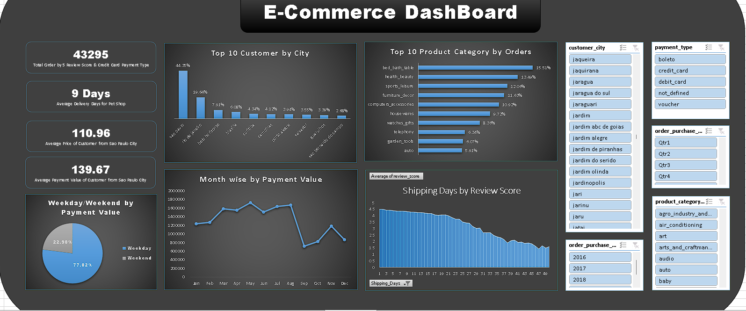
EXCEL

Slide 14
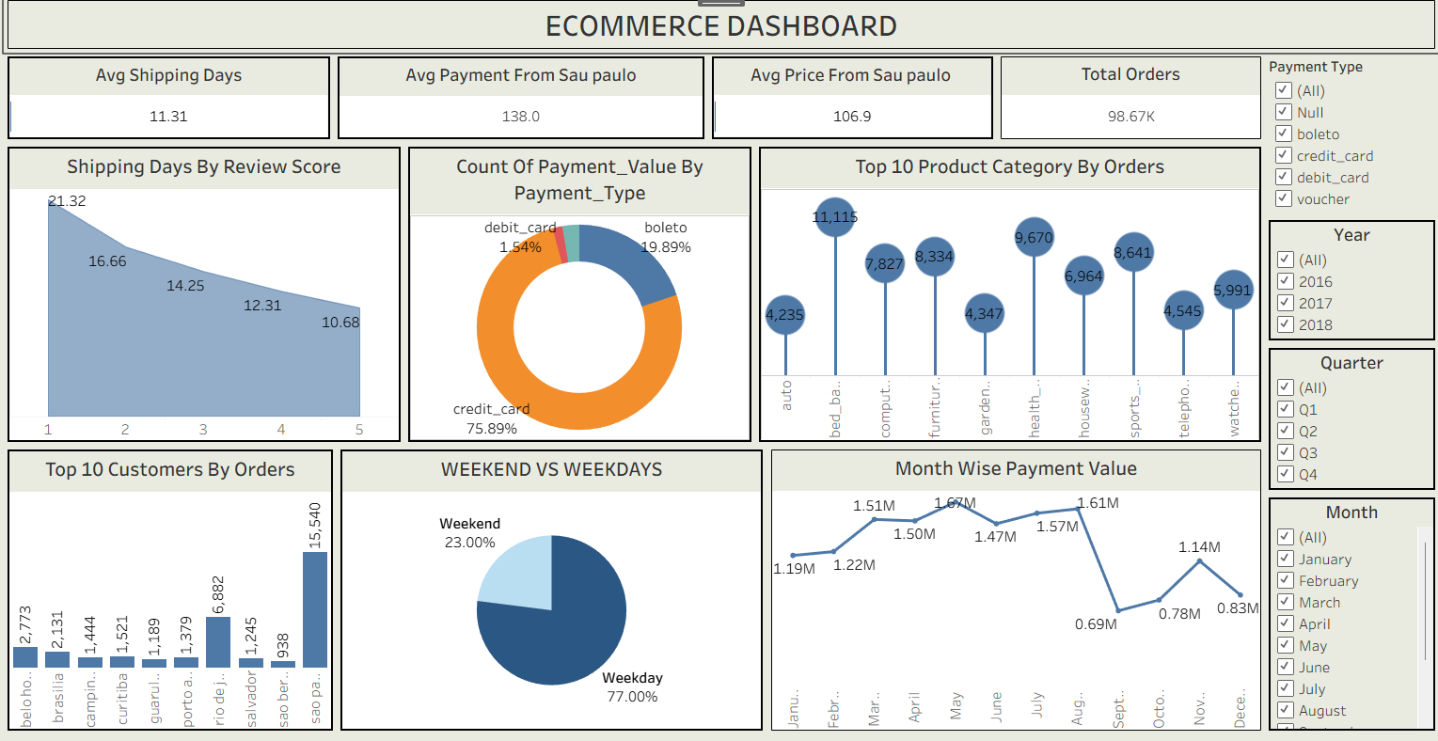
TABLEAU

Slide 15
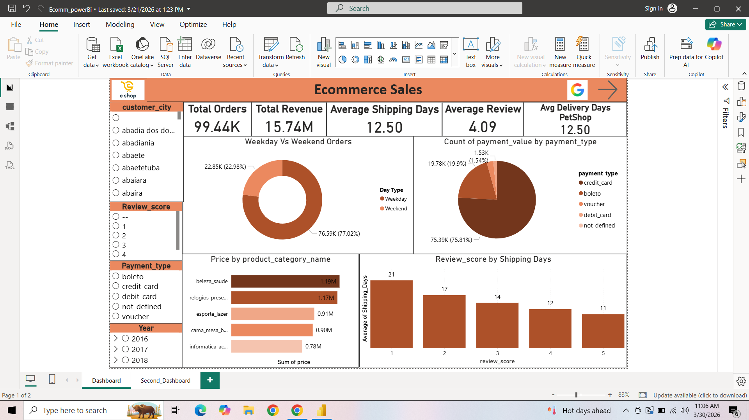
POWER BI

Slide 16
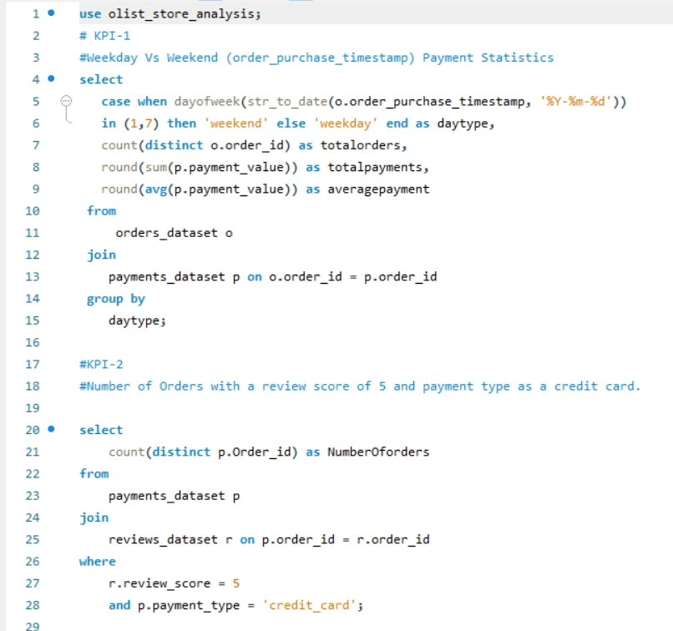
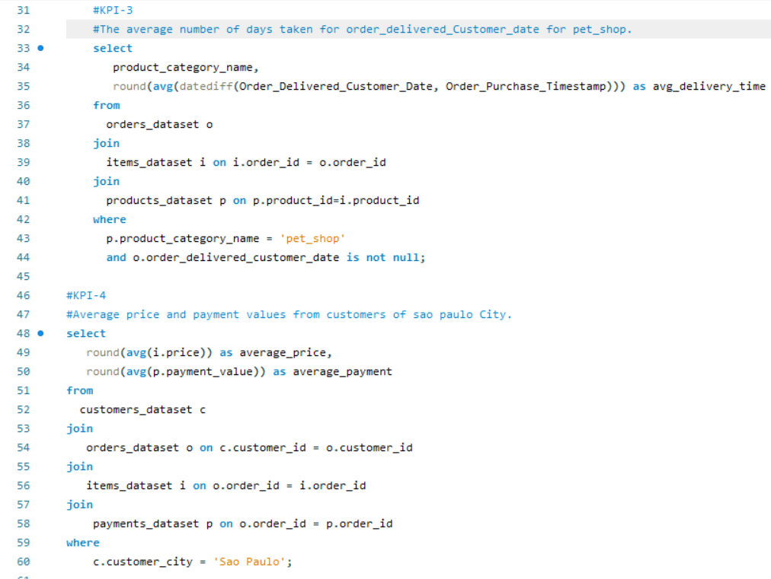
SQL

Slide 17
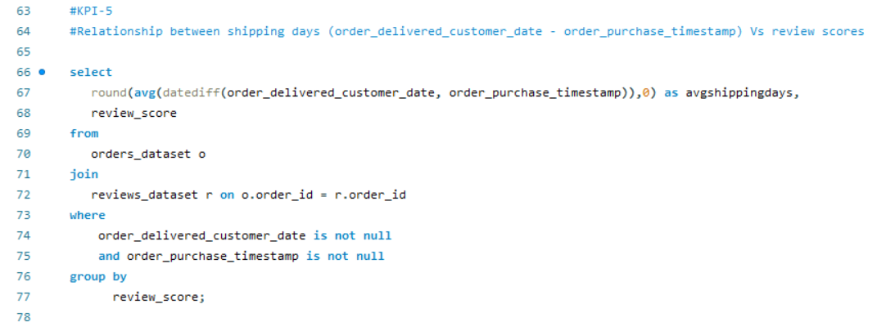

Slide 18
Conclusion
The project successfully analyzed the Olist e-commerce dataset using multiple analytical tools.
Data was transformed and processed at each stage to ensure accuracy and consistency.
Key KPIs helped uncover important trends in sales, payments, delivery performance, and
customer satisfaction.
Visual dashboards made complex data easy to understand and interpret.
The analysis provided actionable insights to support business decision-making.
Overall, the project strengthened practical skills in data analysis, SQL, and data visualization.

Slide 19
CHALLENGES & LEARNINGS
Learnings :
Gained hands-on experience in data cleaning and transformation
Improved understanding of SQL joins and KPI calculations
Learned how to analyze real-world business data
Developed skills in tableau and power BI dashboard creation
Enhanced data storytelling and presentation skills
Understood how data insights support business decisions
Challenges :
Handling and understanding a large dataset with multiple CSV files
Managing data inconsistencies across different tables
Performing correct joins between multiple relational tables
Cleaning and transforming data at every stage of the analysis
Selecting appropriate kpis and charts for business analysis
Learning and using multiple tools simultaneously

Slide 20
Thank you

